Slide 1

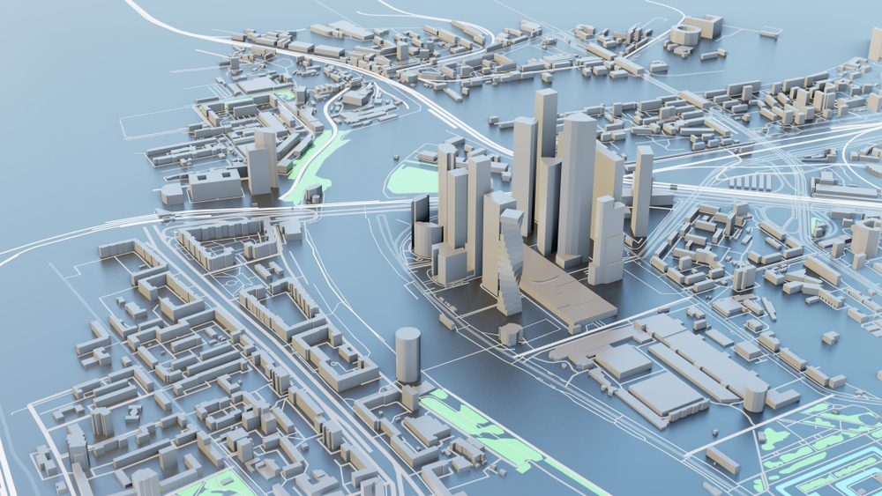

CE432 - Geographic Information System
3D GIS
Application for 3-Dimensional GIS
Instructor: Dr. Salil Goel
Anant Gauniyal (220132)
Aayush Sidana (220023)
Amipriya Anand (220122)

Slide 2
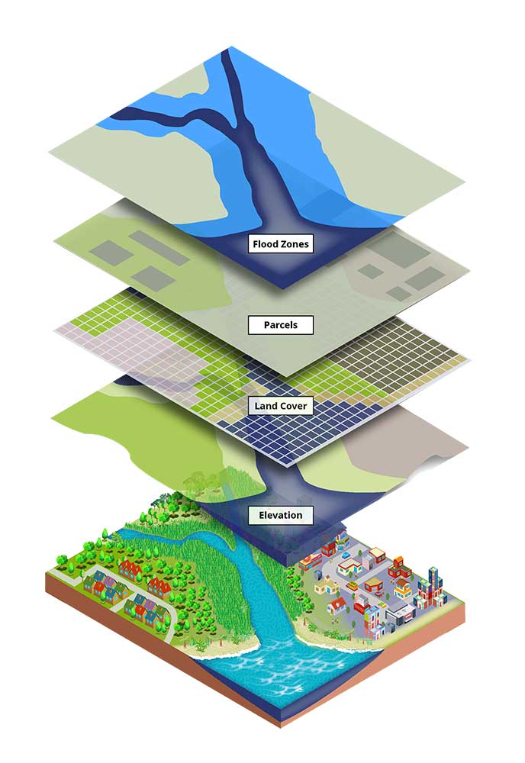
THE EVOLUTION OF GIS
Traditional 2D GIS
Limitations:
Misses Real-World Complexity
Only 2D
Need for 3D GIS ?
Adds Height & Depth
Better Visualization of:
Terrain
Urban Models
Disaster Analysis
But Why ?

Slide 3
Objective
Explore 3D GIS Applications
FOCUS: FLOOD RISK IDENTIFICATION USING ELEVATION DATA
Use elevation data to create topographic maps and simulate flood scenarios, aiding in flood risk identification, emergency planning, and sustainable urban development.
How this can be done ?
TOOLS: QGIS, PYTHON
Outcome: Improved Spatial Analysis & Planning

Slide 4

WHY 3D GIS?
2D GIS
3D GIS
Urban Morphology Limitations
Captures Terrain
Underground Utilities
Complex Infrastructure
Driven by LiDAR
Photogrammetry
Satellite Data

Slide 5
METHODOLOGY
Data Acquisition: Download DEM Tiles
Load & Merge Tiles in QGIS
Apply Elevation Thresholds
Extract Flood-Prone Zones
3D Visualization
Python: Load DEM, Downsample, 3D GridApply
Threshold, Highlight Flood Zones
Render 3D Terrain with PyVista
DEM-BASED FLOOD SIMULATION (QGIS)
PYTHON-BASED 3D VISUALIZATION

Slide 6
QGIS WORKFLOW
Apply Threshold
Start
Download & Extract Tiles (.tif)
Merge Rasters
Raster Calculator
3D Model Extraction
Download DEM from Bhuvan NRSC
Flood-Prone Areas
Select Area of Interest
Load Tiles in QGIS
Check Elevations
Visualize

Slide 7
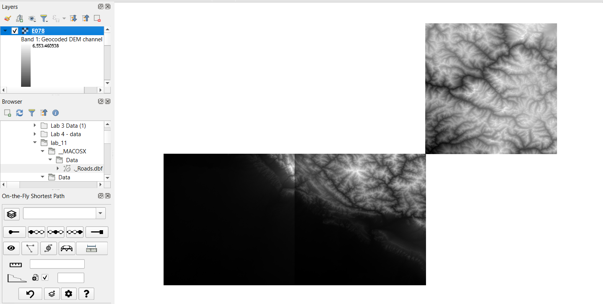
Raw Data from Bhoonidhi

Slide 8
PYTHON CODING WORKFLOW
Load
Clean
Generate
Structured Grid
Apply Threshold
Highlight
Load Merged DEM with rasterio
Clean & Downsample Data
Generate Meshgrid (X, Y, Z)
Create Structured Grid (PyVista)
Apply Flood Threshold
Highlight Flood Zones in Blue
Render 3D Terrain
Final Step ----->

Slide 9

RESULTS: QGIS
2D Raster: Elevation Threshold Applied
Binary Mask: Flood-Prone ( 1 ), Safe ( 0 )
Color Symbology: Blue = Flood, White = Safe
3D Model: Enhanced Terrain Perception

Slide 10
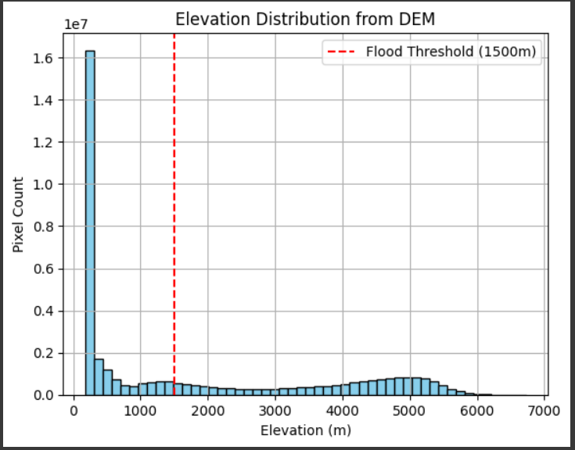
RESULTS: PYTHON
Downsampled DEM
3D Surface Plot (PyVista)
Threshold Mask: Flood Zones in Blue
Compare with QGIS Output

Slide 11
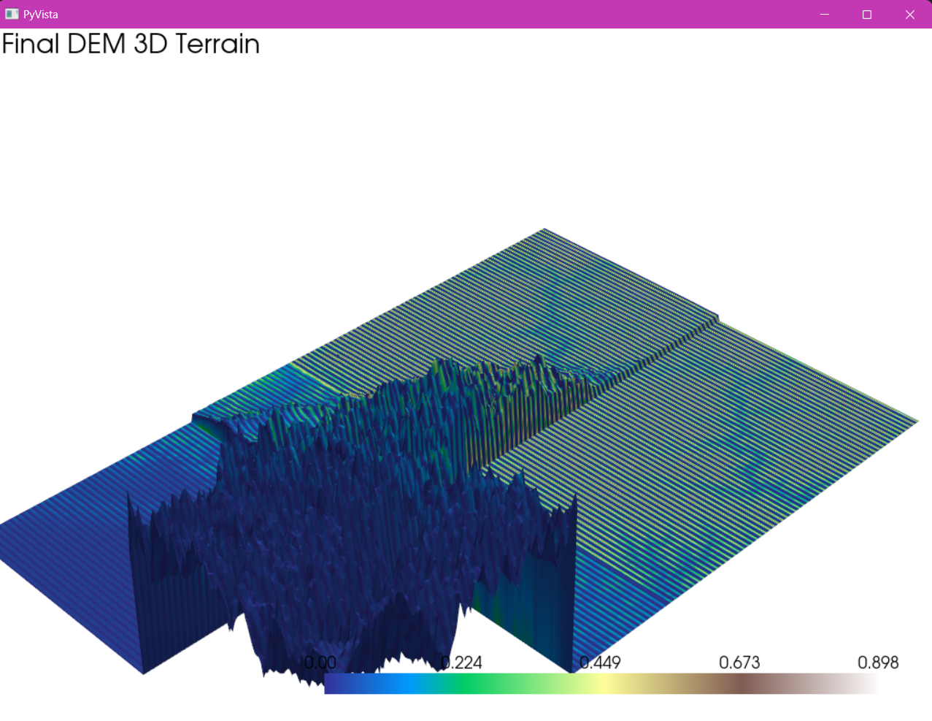
The blue peaks we’re seeing are elevations above 1500 meters
Green, Yellow, and Brown is lower than that implying Deep Blue → Higher elevation, hence tending towards 0 in a binary mask

Slide 12
Findings:
Low Areas = High Flood Risk
02
03
Limitations:
NoData
Projection Issues
Downsampling Loss
QGIS:
Quick Raster Operations
Insights & Limitations
01
Need for careful data alignment
05
Python:
Custom 3D Visualization

Slide 13
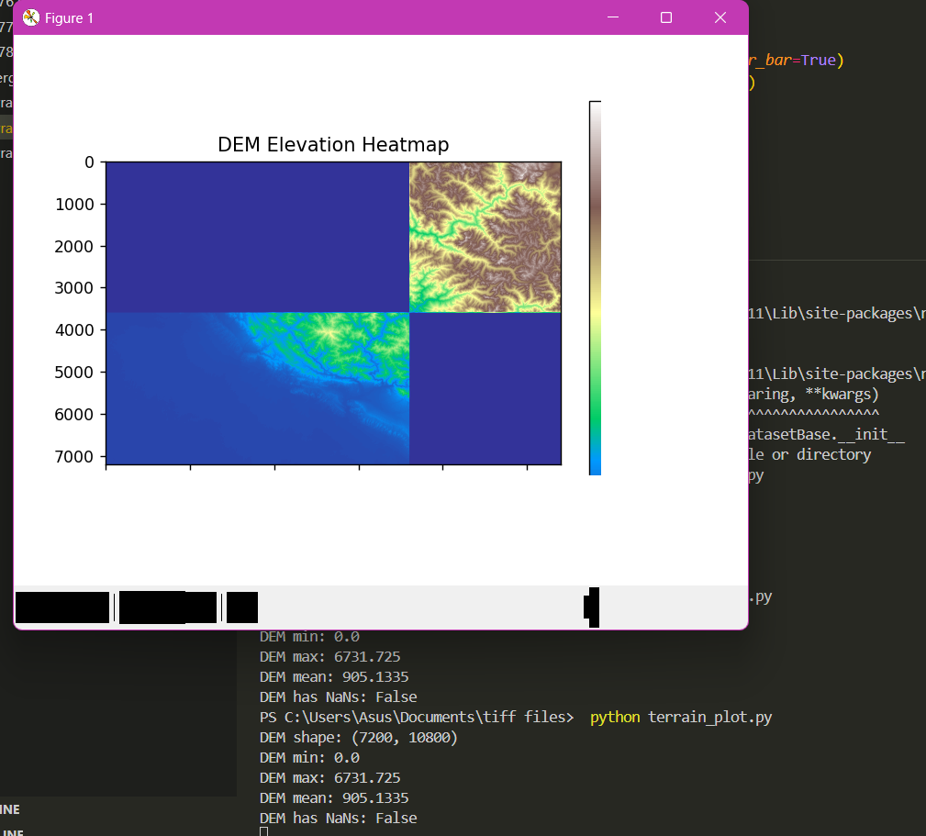
CONCLUSION & FUTURE DIRECTIONS
3D GIS: EFFECTIVE FOR FLOOD RISK MAPPING
COMBINES VISUAL & ANALYTICAL POWER
FUTURE:
DIGITAL TWIN INTEGRATION
REAL-TIME DATA
SUPPORTS URBAN PLANNING, DISASTER MANAGEMENT

Slide 14
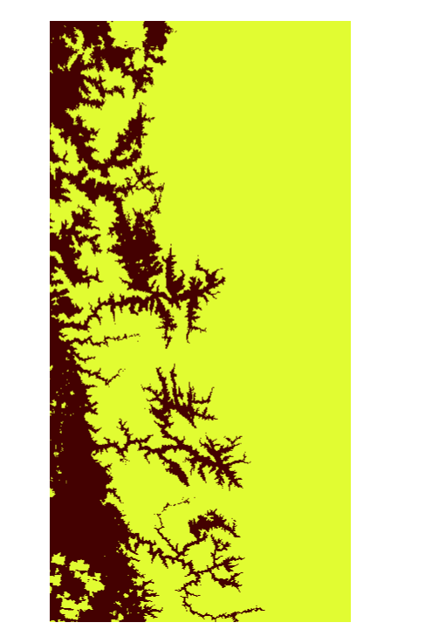
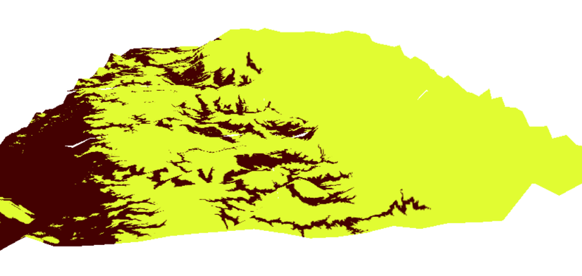
Other Application of 3-D GIS
Data: Western Maharashtra
Apply 1-5m Elevation Threshold
Generate Binary Mask: Red=Risk, Yellow=Safe
2D/3D Visualization in QGIS & Python
3D Visualization
2D Visualization
Why This Matters:
Identifies vulnerable coastal regions for climate adaptation planning.
Demonstrates workflow transferability from flood to sea-level risk analysis.

Slide 15
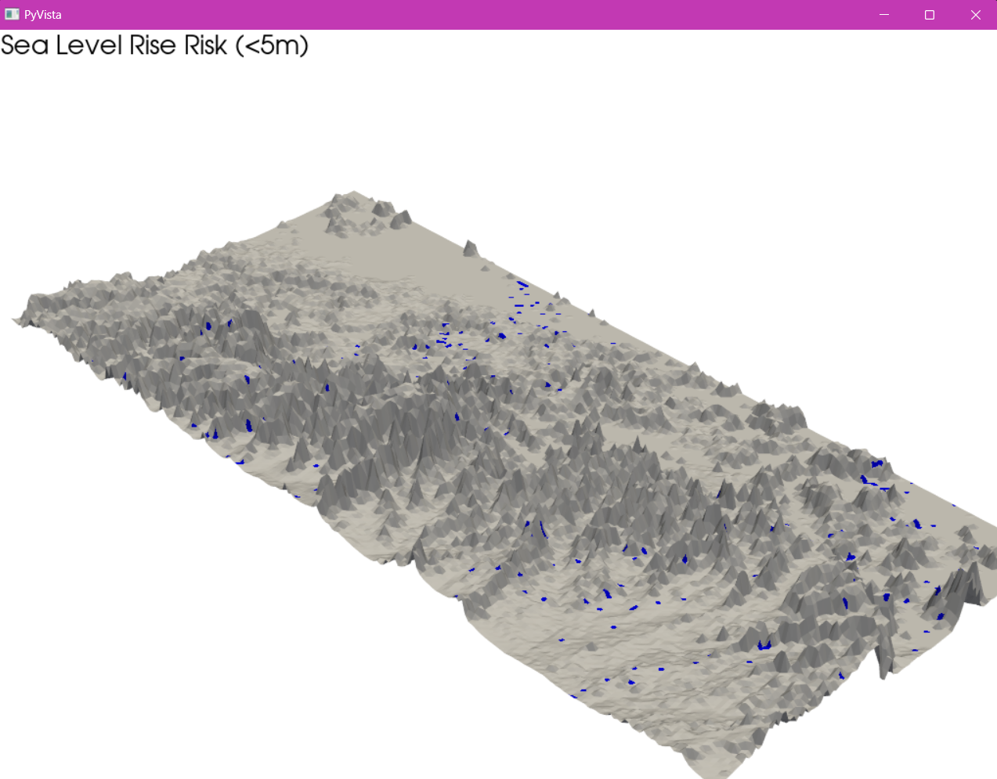
Sea Level Risk (<5m)

Slide 16
KEY TAKEAWAYS
3D GIS = ENHANCED SPATIAL INSIGHT
BETTER RISK IDENTIFICATION
SUPPORTS DATA-DRIVEN DECISIONS
FLEXIBLE: QGIS + PYTHON

Slide 17
THANK YOU
Questions?
Link to Presentation in Canva
Link to Presentation in Canva

